Slide 1
The Controller Placement Problem in SDN: A Survey
Guodong Wang, Yanxiao Zhao, Jun Huang, and Wei Wang

Slide 2
SDN Benefits
Simplifying the network management
Improving the efficiency of network utilization
Enabling network innovations

Slide 3
Controller Placement Problem
Openflow standard (One controller)
Scalability and performance issues when the network scale continually expands.
Multiple Controller Approaches
Controller Placement Problem
Undirected Graph G = (V,E)
Dijkstra used to represent distance between switches
Solution Set: {k; C; S} (k – centre problem)

Slide 4
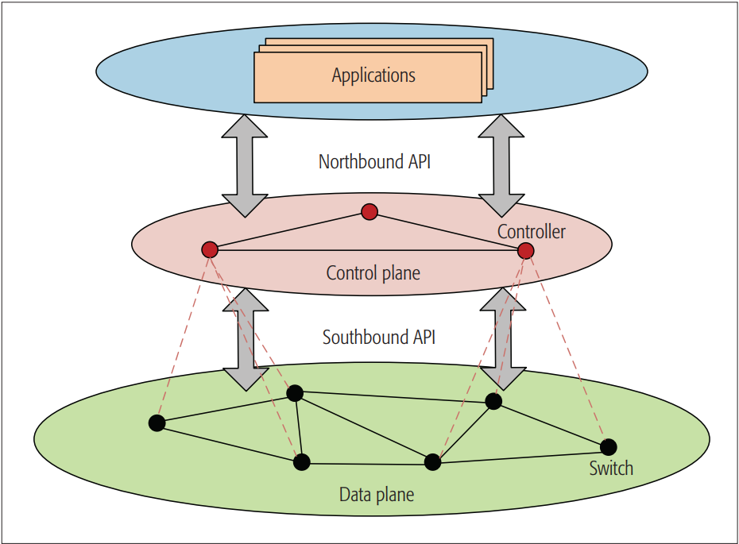
Layered Structure

Slide 5
Objectives of Controller Placement
Minimize latency between controllers and their associated switches => Packet propagation latency
K center problem
NP hard to K-median problem
Enhance reliability and resilience of the network
Use of redundant links (Survivor)
Path diversity => increases survivability
Minimize deployment cost and energy consumption
90 % energy lost during idle time

Slide 6
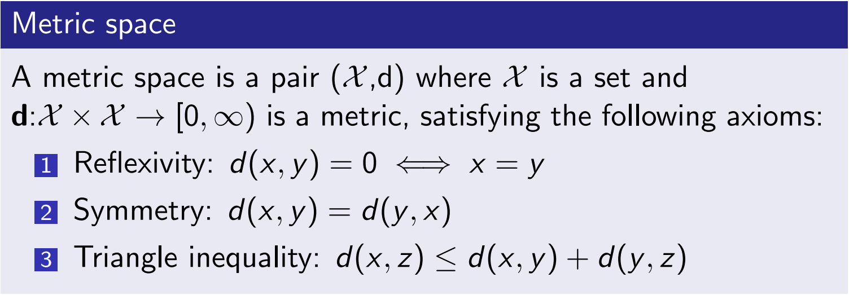
Algorithms
Already well known clustering algorithms
K centre algo like greedy, local search
K means
They use euclidean distance which is not appropriate
They require a Metric Space
No 3 is problematic

Slide 7
Proposed Algorithm - CNPA
Cluster based Network Partition Algorithm
Preprocessing
Adjacency matrix
Co-ordinates (Google Map)
Distance (Haversine Formula)
Switch to switch distance using Dijkstra
Apply CNPA algorithm which keeps dividing the network into clusters until k centers are formed

Slide 8
CNPA
Randomly Select center
Find each nodes' sum distance from all other nodes and select node with minimum as centroid
Second center -> furthest from clusters centroid
Centroid (c1) and center (c2) as initial centers and assign nodes using distance measures ( d(ni, c1) and d(ni, c2) ) and compare
Keep repeating this process from step 2 until k sub networks are formed

Slide 9
Network Details
34 nodes (all over Canada to USA)
43 links in total
Maximum distance (shortest path distance) is 3120 miles (50 ms round trip)
Experiment done 100 times
Propagation Latency = distance(m)/(2x10^8 m/s)

Slide 10
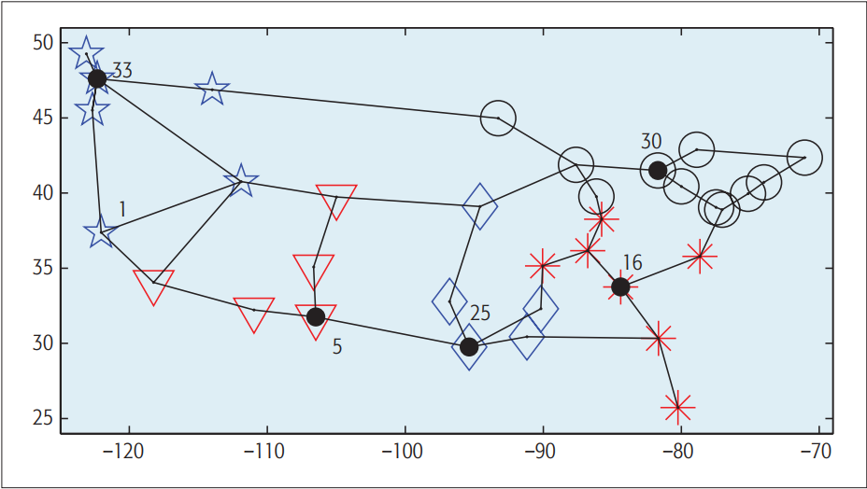
CNPA for k = 5

Slide 11
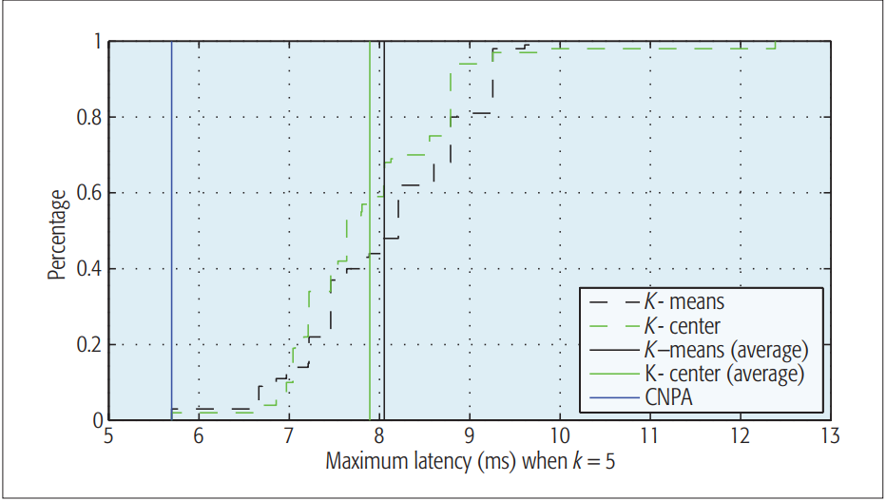

Slide 12
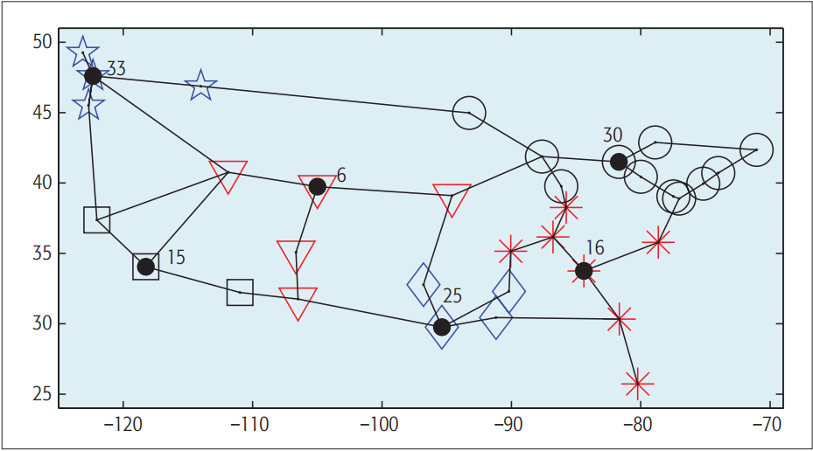
CNPA for k = 6

Slide 13
